Slide 1


JSPM’s
Rajarshi Shahu College of Engineering, Tathawade, Pune
(An Autonomous Institute affiliated to Savitribai Phule Pune University)
Department of Computer Science and Business Systems
Academic Year: 2026-27
Project Title:
Smart Parking Management System
Students Name and PRN no:
Tech Stack
Parth Mohurle - RBT25ET072(68)
Database: MySQL (3NF)
Front end: Python Tkinter GUI
Connector: mysql-connector-python
Roles: Admin / Attendant
Saurav Bhonde - RBT25ET027(67)
Date: 27-10-2026
Course Name: Database Management System
Course Coordinator: Prof. Rutuja S. Bachhav

Slide 2
Index
1
Introduction
6
Database Design & ER Diagram
2
Problem Definition & Objectives
7
SQL Implementation & Results
3
Literature Survey
8
Application Screenshots
4
Feasibility Study
9
Conclusion & Future Scope
5
System Design & Architecture
10
References

Slide 3
Introduction / Background
Definition: A database-driven desktop application that manages parking lots, slots, vehicles, entry/exit and billing.
Overview: Python Tkinter front end with a MySQL back end (two-tier), built on a normalized (3NF) schema of nine tables.
Background: Parking lots still depend on paper tickets and registers, which are slow, error-prone and hard to audit.
Motivation: Automatic slot allocation, accurate fees and live availability, with a simple multi-tab interface.
Vehicles & Owners
vehicle_owners and vehicles: plate number, type, owner name, phone, email
Lots & Slots
parking_lots and parking_slots: capacity, slot type and live status
Records & Payments
parking_records, payments, reservations and pricing: every visit and its fee

Slide 4
Problem Definition & Objectives
Problem
Objectives
Manual ticketing causes wrong slot status, duplicate entries, fee calculation errors and long searches for a vehicle.
There is no live view of free slots and no quick daily revenue report.
A database-driven system is needed to allocate slots, bill vehicles and report revenue accurately.
Store vehicle, owner, lot and slot data in a normalized 3NF schema
Auto-allocate the first free slot matching the vehicle type
Update slot status automatically with a MySQL trigger
Calculate the fee (hours rounded up × rate) and record payment
Support slot reservations and role-based access (admin / attendant)
Show a live dashboard, history reports and CSV export

Slide 5
Literature Survey
Aspect | Existing system (manual / ticket-based) | Proposed system (MySQL + Python)
Slot allocation | Attendant picks a slot by sight; double allocation possible | Closest matching free slot allocated automatically
Vehicle lookup | Paper tickets and registers; slow to search | Search by plate number with indexed lookup
Fee calculation | Manual time and rate calculation; human errors | Stored procedure: hours rounded up × hourly rate
Slot status | Updated by hand; often out of date | MySQL trigger sets Occupied / Available
Reservations | Not supported or tracked in notebooks | Book and cancel slots from the GUI
Reporting | Totals counted by hand at end of day | Dashboard, filters, revenue report, CSV export
Manual methods suit a very small lot but become difficult to manage as vehicles, slots and transactions increase.

Slide 6
Feasibility Study
Technical Feasibility
Financial / Business
Operational Feasibility
Python 3 with Tkinter and MySQL are mature, well-documented tools
mysql-connector-python links the GUI to the database
Runs on an ordinary PC; MySQL Workbench verifies the data
Python, MySQL, Workbench and VS Code are freely available
No special hardware or licences needed
Reduces revenue leakage from billing mistakes
Simple tabbed interface; no SQL knowledge needed
Login, input validation and clear error messages
Replaces paper tickets with faster, accurate records

Slide 7
System Design & Architecture
Client Tier
Database Tier
Python 3 + Tkinter GUI (ttk.Notebook)
MySQL Server (3NF, nine tables)
Login with admin / attendant roles
Dashboard, Vehicle Entry, Vehicle Exit
Slot Management and Reservations
Records & Reports, Admin Panel
mysql-connector-python
Tables with PK, FK, UNIQUE, CHECK
Trigger: slot status Occupied / Available
Stored procedure: parking fee
View v_lot_availability, index on plate_number
Parameterized SQL, transactions
Vehicle exit & billing flow
1
Search vehicle by plate number
2
Find active record, compute duration
3
Fee = hours (rounded up) × rate
4
Record payment (Cash / UPI / Card)
5
Mark record Completed
6
Trigger frees the slot

Slide 8
Database Design & ER Diagram
vehicle_owners
vehicles
parking_records
payments
owner_id
name
phone
email
1
M
vehicle_id
plate_number (UNIQUE)
vehicle_type
owner_id (FK)
1
M
record_id
vehicle_id (FK)
slot_id (FK)
entry_time
exit_time
status
1
M
payment_id
record_id (FK)
amount
payment_mode
payment_time
1
M
M
1
pricing
reservations
parking_slots
parking_lots
vehicle_type
rate_per_hour
reservation_id
vehicle_id (FK)
slot_id (FK)
reserve_from
reserve_to
status
M
1
slot_id
lot_id (FK)
slot_number
slot_type
status
M
1
lot_id
lot_name
location
total_capacity
users
user_id
username
password_hash
role
Relationships: one owner has many vehicles; one vehicle has many records and reservations; one lot has many slots; one slot has many records and reservations; one record has payments. (FK) = foreign key, underlined = primary key.
pricing and users are standalone (rate is looked up by vehicle_type)

Slide 9
SQL Implementation & Results
Lot Availability (VIEW)
Active Vehicles (JOIN)
Daily Revenue (GROUP BY)
SELECT lot_id, lot_name,
location, capacity,
available, occupied,
reserved, maintenance,
occupancy_pct
FROM v_lot_availability;
SELECT r.record_id,
v.plate_number,
o.name AS owner,
s.slot_number,
r.entry_time
FROM parking_records r
JOIN vehicles v
ON v.vehicle_id = r.vehicle_id
JOIN vehicle_owners o
ON o.owner_id = v.owner_id
JOIN parking_slots s
ON s.slot_id = r.slot_id
WHERE r.status = 'Active';
SELECT DATE(payment_time)
AS day,
SUM(amount) AS revenue,
COUNT(*) AS payments
FROM payments
GROUP BY DATE(payment_time)
ORDER BY day DESC;
Live capacity, free, occupied and reserved slots per lot; feeds the dashboard.
Combines four tables through their keys to list vehicles parked now.
Revenue per day using the SUM aggregate; shown in Daily Revenue Analytics.
Verification: SHOW TABLES in MySQL Workbench confirms the nine tables; output screenshots follow.

Slide 10
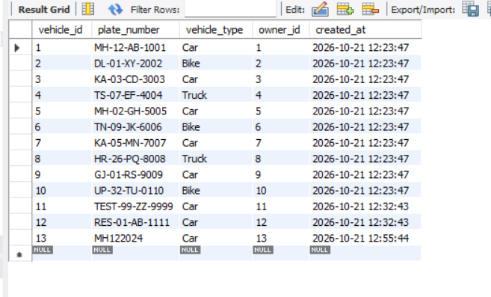
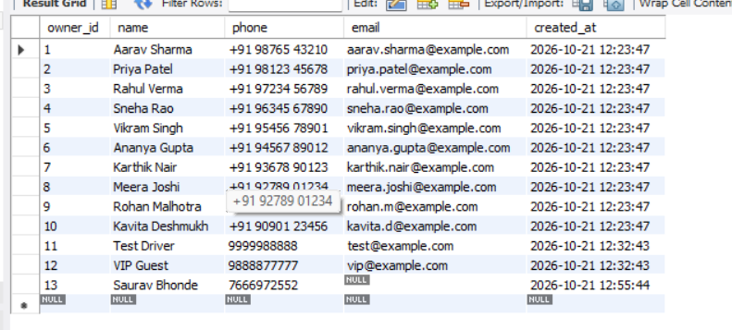
Database Tables in MySQL Workbench
vehicle_owners table: 13 records
vehicles table: 13 records
Link: vehicles.owner_id references vehicle_owners.owner_id, so every vehicle belongs to one owner and one owner may have many vehicles. plate_number is UNIQUE and indexed for fast lookup.

Slide 11
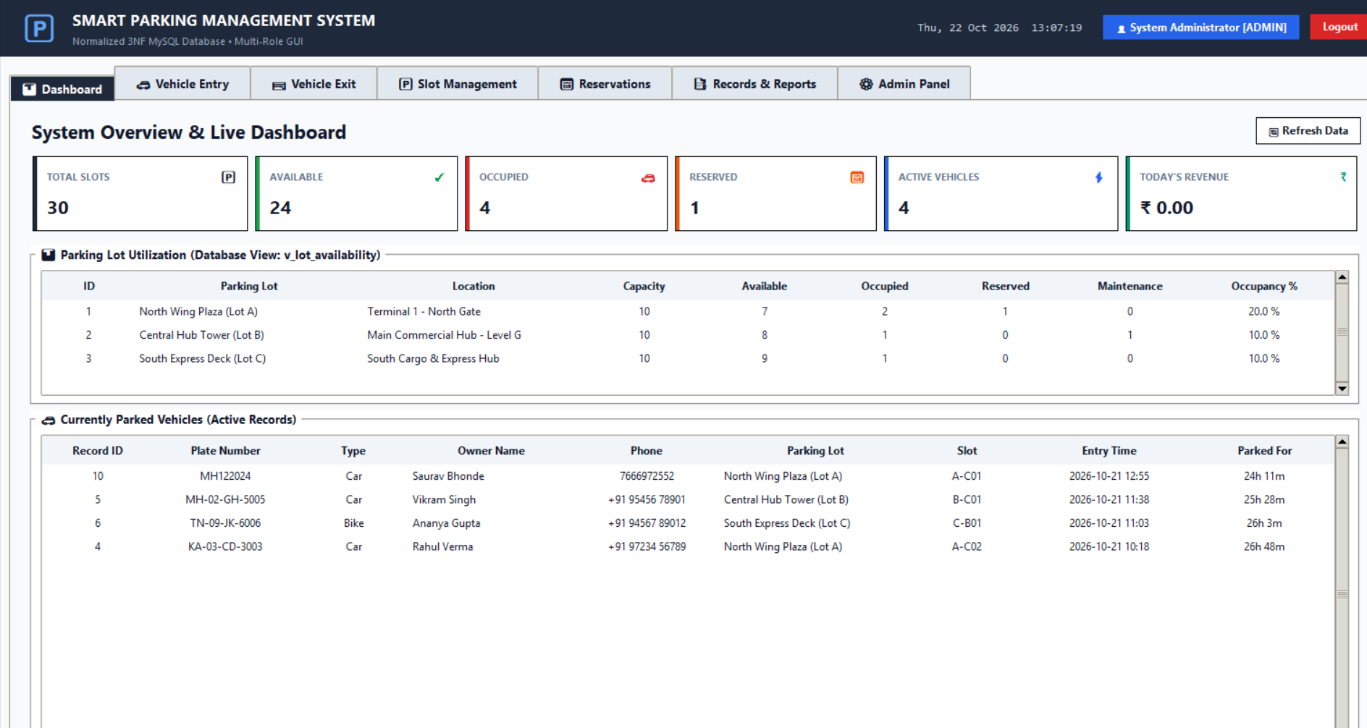
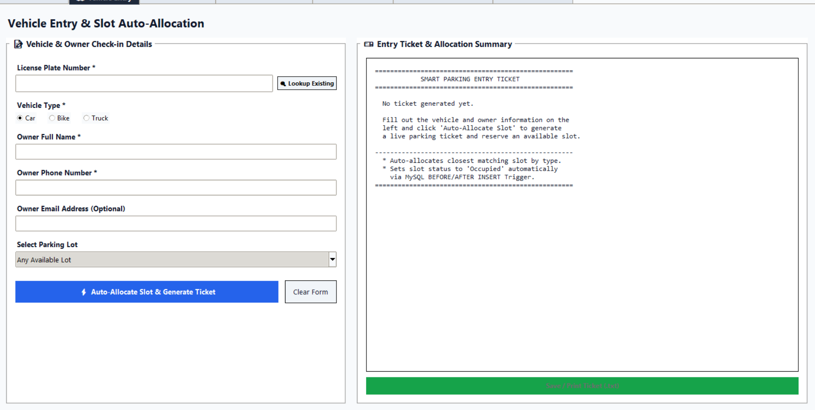
Application Screenshots
Vehicle Entry: auto-allocation and ticket
Dashboard: live slots, revenue and parked vehicles
Dashboard: 30 slots across 3 lots, available / occupied / reserved counts, lot utilization from the view.
Entry: Owner and vehicle details; the first matching free slot is allocated and a ticket generated.

Slide 12
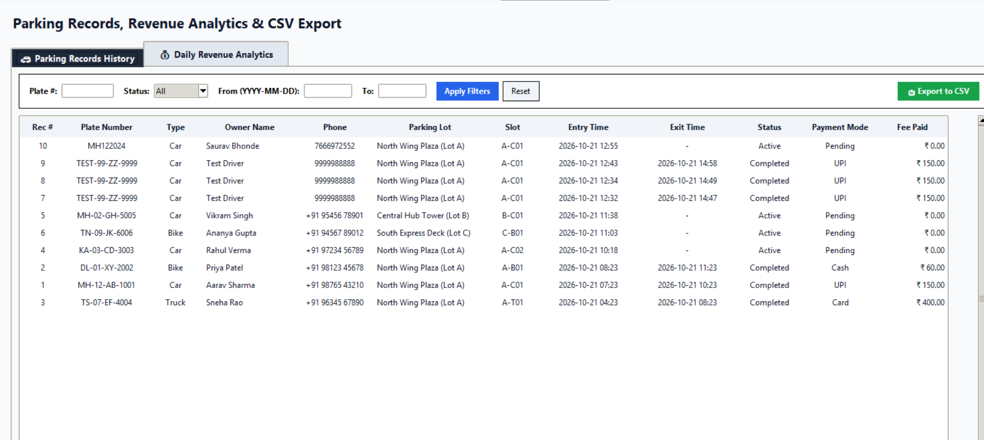
Records, Reports & CSV Export
Filter by plate number, status and date range
Shows owner, lot, slot, entry/exit time, payment mode and fee
Daily Revenue Analytics tab
Export to CSV for reporting
Parking Records History with filters

Slide 13
Conclusion
Conclusion
Future Scope
Demonstrates DBMS concepts using MySQL and Python in a two-tier architecture
Nine normalized (3NF) tables linked with primary and foreign keys
Trigger, stored procedure, view and index automate slot status, fees and availability
Parameterized queries, hashed passwords and transactions keep data safe
Faster entry/exit and accurate reports compared to manual records
Number plate recognition with a camera
Online reservation and UPI QR payment
SMS / email alerts for reservations and dues
Sensor-based slot detection (IoT)
Monthly passes and dynamic pricing
Web or mobile app interface

Slide 14
References
MySQL Documentation, Oracle Corporation.
MySQL Workbench Documentation, Oracle Corporation.
MySQL Connector/Python Developer Guide, Oracle Corporation.
Python Documentation: tkinter, Python interface to Tcl/Tk, Python Software Foundation.
W3Schools, SQL Tutorial.
GeeksforGeeks, DBMS and SQL Concepts.
Database Management System course notes and classroom materials.

